Slide 1

I4SWD Handin2 – Group 50
Command Pattern

Slide 2
Purpose of Command Pattern
Pros:
Macro instructions are easy
Decreases dependency/coupling of the system
Encapsulating commands/requests as objects
Cons:
Increased number of classes
Intent:
Parameterization
Saves requests in a queue
Supports undoable operations

Slide 3
Type of Pattern
Creational Design Pattern
Structural Design Pattern
Behavioral Design Pattern
Communication between objects

Slide 4
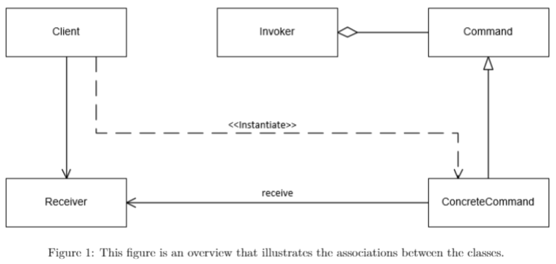
Command Pattern
Contains:
Client
Invoker
Receiver
Command
ConcreteCommand

Slide 5
Related Patterns
Command Pattern | Strategy Pattern
Uses encapsulation | Uses encapsulation
Small level | Abstract level
Actions | Algorithms
Command Pattern | Memento Pattern
Can undo & redo | Can undo & redo
Single state | Multiple states at once

Slide 6
S.O.L.I.D principles
S: SRP – Single Responsibility Principle
O: OCP – Open-Closed Principle
L: LSP – Liskov Subsitution Principle
I: ISP – Interface Segregation Principle
D: DIP – Dependency Inversion Principle

